Slide 1
America the Beautiful
美丽的美国
中文歌词、演唱、视频制作:
北美保守评论交予伶长团队

Slide 2
何等美丽，辽阔天空，
金色麦浪重重
O beautiful for spacious skies，
For amber waves of grain，

Slide 3
耸立在上巍巍群山，
俯瞰富饶平原
For purple mountain majesties
Above the fruited plain!

Slide 4
America! America!
上帝施恩给你
America! America!
God shed his grace on thee

Slide 5
使你良善，赐你平安，
四海内皆兄弟！
And crown thy good with brotherhood
From sea to shining sea!

Slide 6
何等美丽，拓荒脚步
追求神圣国度
O beautiful for pilgrim feet
Whose stern impassioned stress

Slide 7
踏过荒野、坚定有力，
开辟自由天地！
A thoroughfare of freedom beat
Across the wilderness!

Slide 8
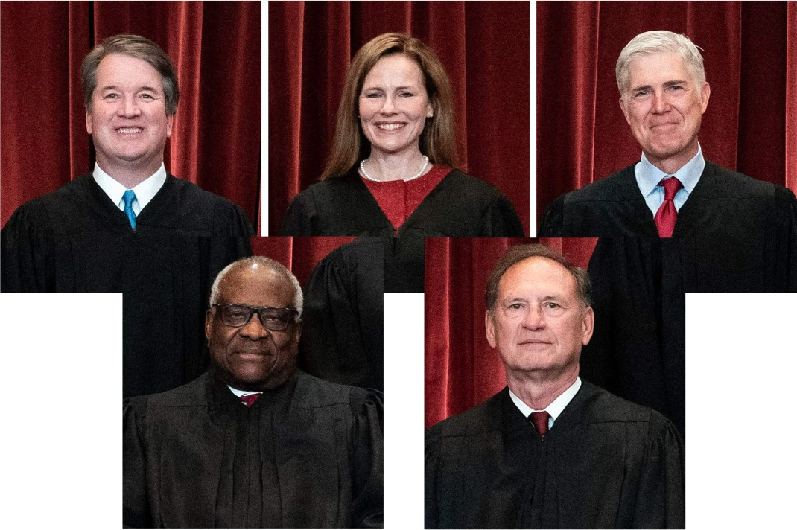
America! America!
主修复你瑕疵
America! America!
God mend thine every flaw，

Slide 9
使你自制坚定无比，
自由法律佑庇！
Confirm thy soul in self-control，
Thy liberty in law!

Slide 10
何等美丽，英雄豪杰
为自由洒热血
O beautiful for heroes proved
In liberating strife.

Slide 11
挚爱祖国胜过爱己，
为仁爱献一切!
Who more than self their country loved
And mercy more than life!

Slide 12
America! America!
你财富主洗涤
America! America!
May God thy gold refine

Slide 13
成就都有崇高目的，
一切收获天赐
Till all success be nobleness
And every gain divine!

Slide 14
何等美丽，爱国梦想！
憧憬未来景象
O beautiful for patriot dream
That sees beyond the years

Slide 15
透过泪眼看见圣城
洁白四射光芒
Thine alabaster cities gleam
Undimmed by human tears!

Slide 16
America! America!
上帝施恩给你
America! America!
God shed his grace on thee

Slide 17
使你良善，赐你平安，
四海内皆兄弟！
And crown thy good with brotherhood
From sea to shining sea!

